Slide 1
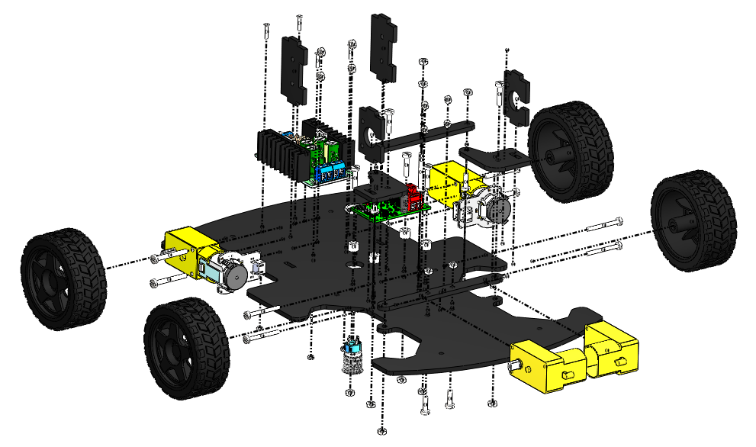
7
6
9
8
5
3
2
1
10
4
12
11

Slide 2
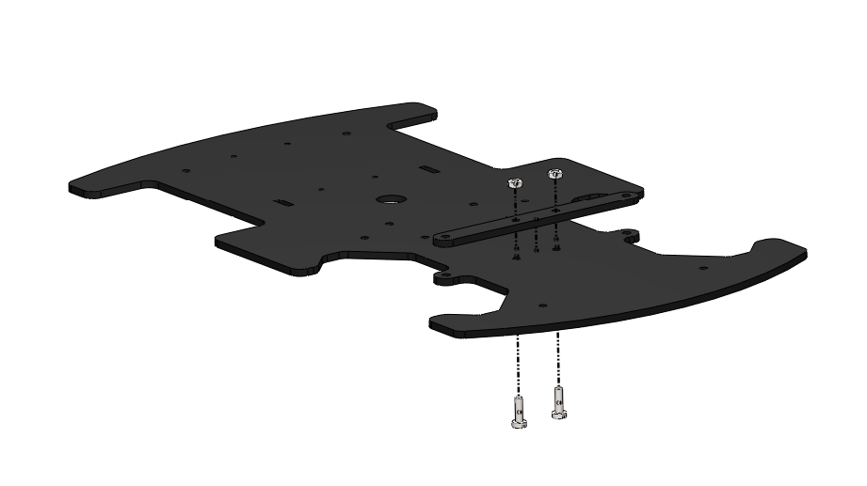
M3 NUT
M3 x 10 BOLT

Slide 3
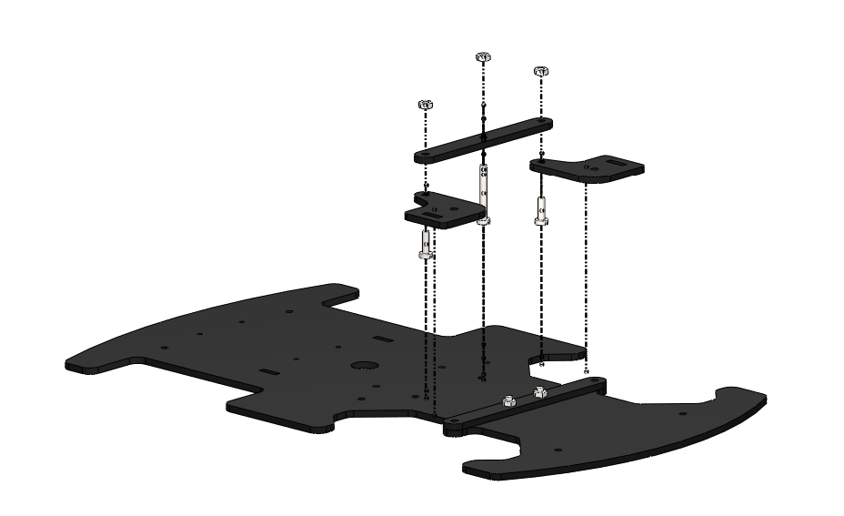
M3 NUT
M3 x 25 BOLT
M3 x 10 BOLT
M3 x 10 BOLT

Slide 4
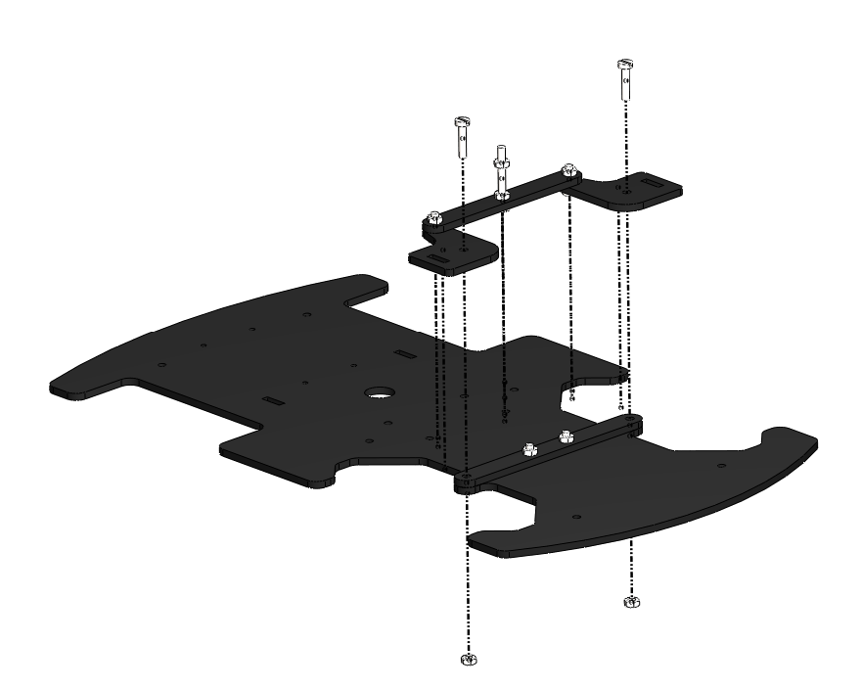
M3 x 14 BOLT
M3 NUT

Slide 5
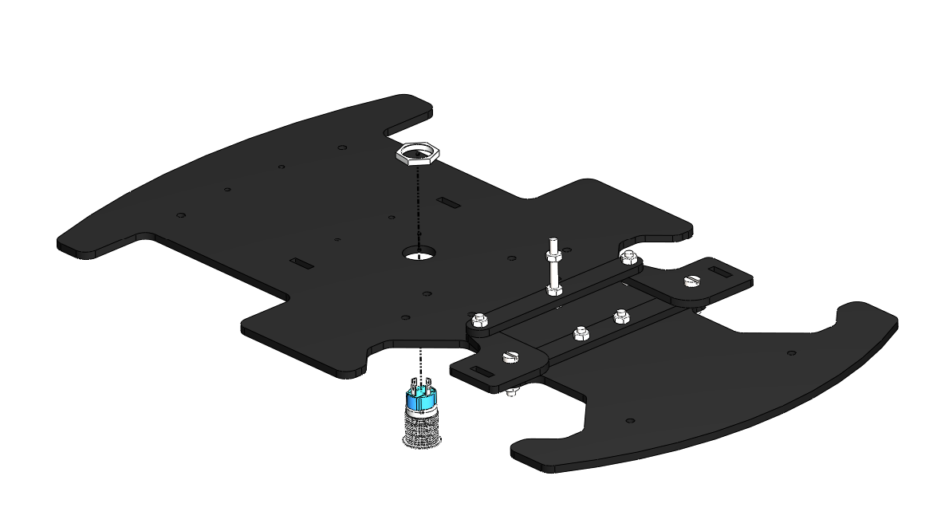
THE SWITCH IS INSERTED INTO THE SLOT FROM BELOW, THEN THE NUT IS TWISTED IN PLACE FROM ABOVE

Slide 6
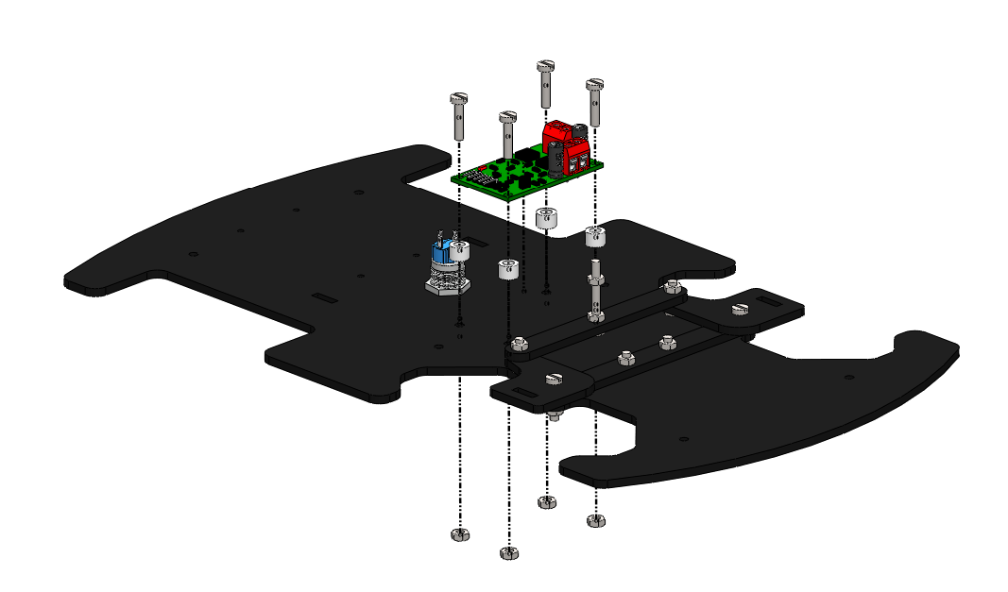
M3 x 14 BOLT
M4 x 5 SPACER
M3 NUT

Slide 7
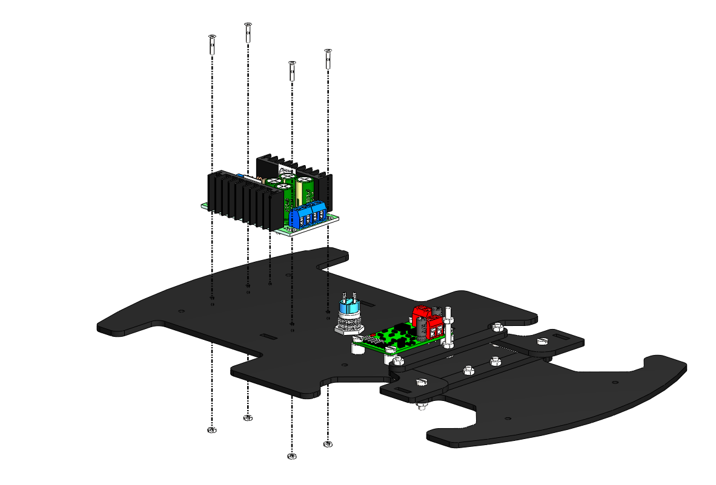
M2 x 10 BOLT
M2 NUT

Slide 8
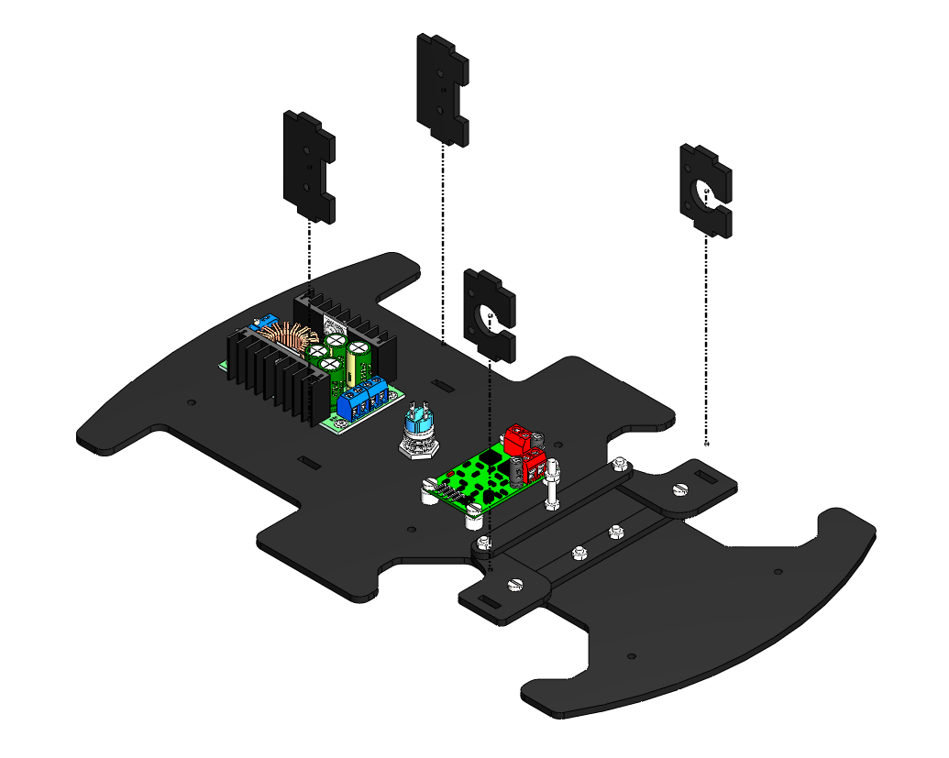
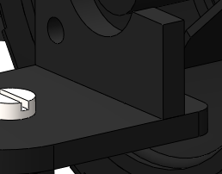
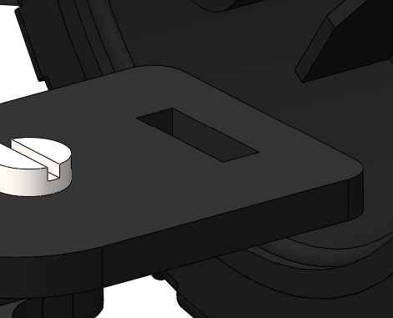
AFTER
BEFORE
THE MOTOR MOUNT IS INSERTED INTO THE SLOT IN THE STEERING KNUCKLE

Slide 9
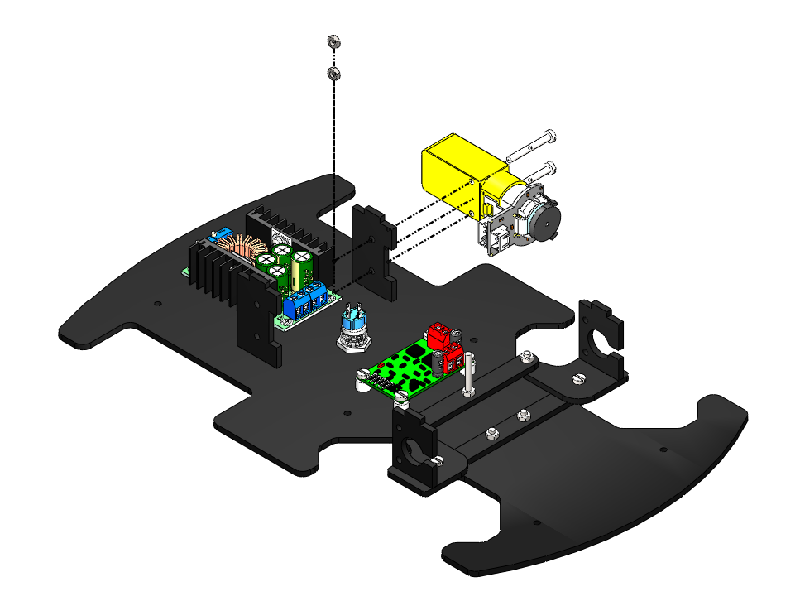
M3 NUT
M3 X 25 BOLT

Slide 10
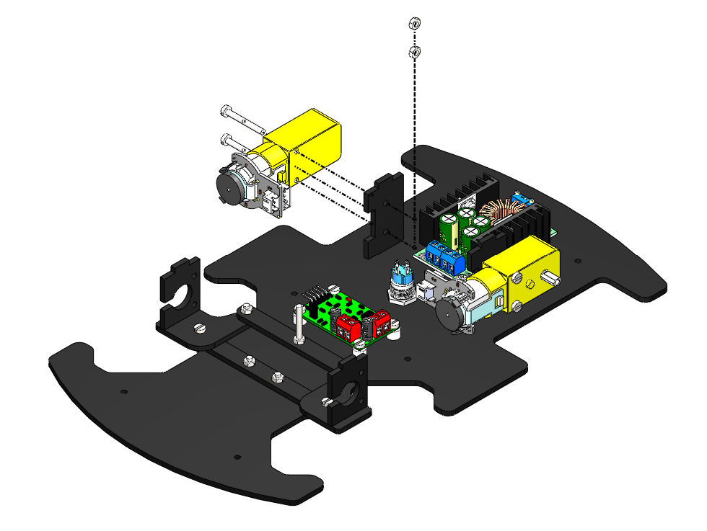
M3 X 25 BOLT
M3 NUT

Slide 11
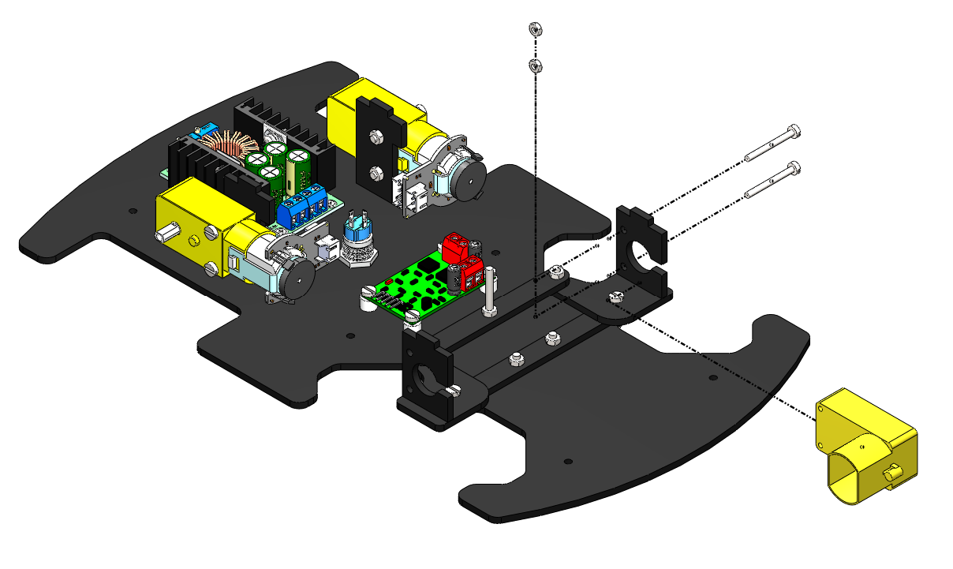
M2.5 NUT
M2.5 x 25 BOLT

Slide 12
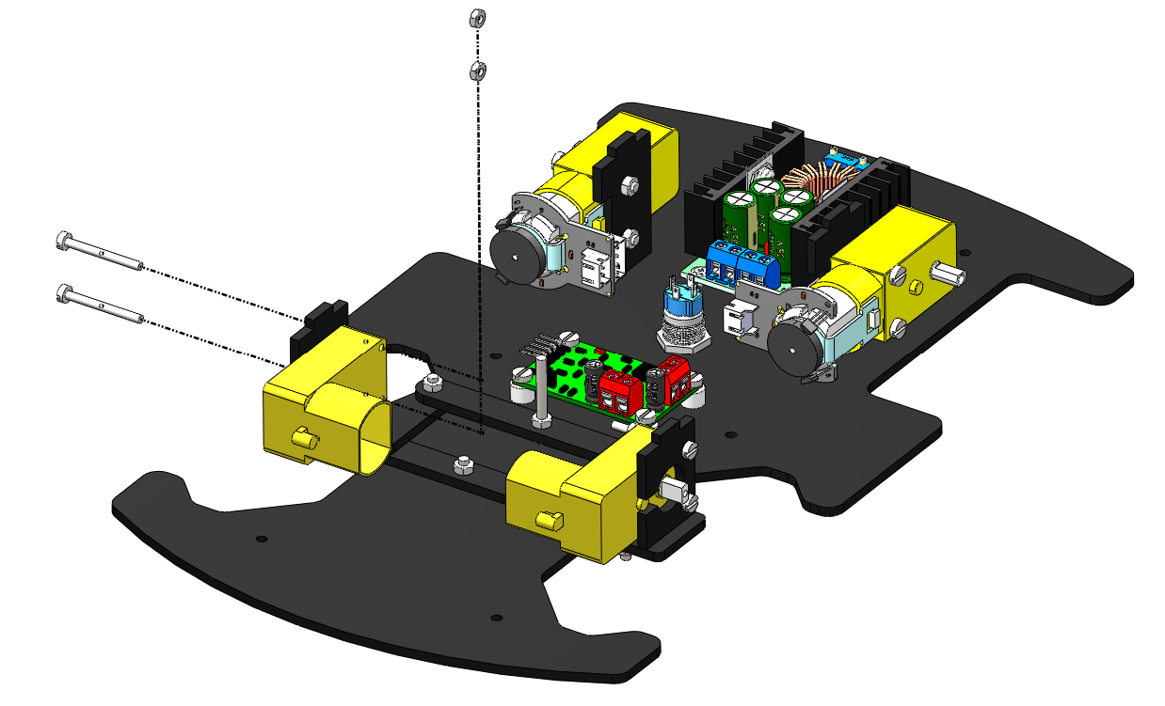
M2.5 NUT
M2.5 x 25 BOLT

Slide 13
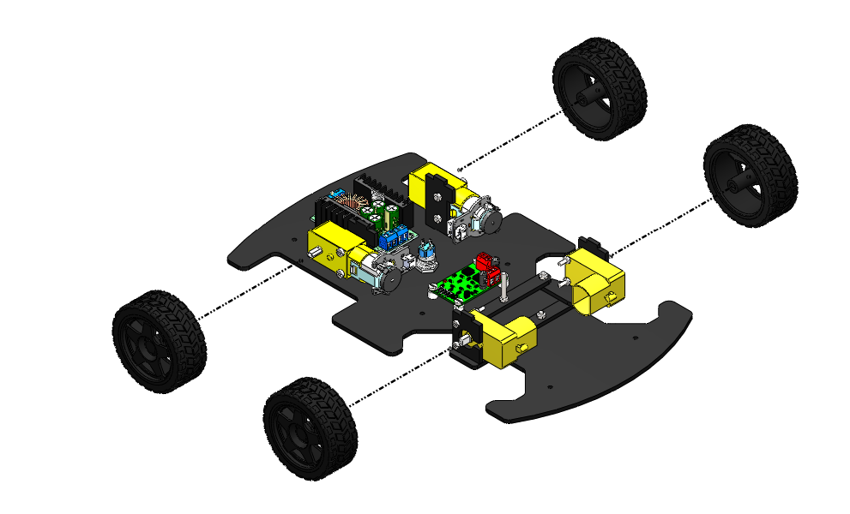
WHEEL PRESS FIT INTO THE MOTOR SHAFT

Slide 14
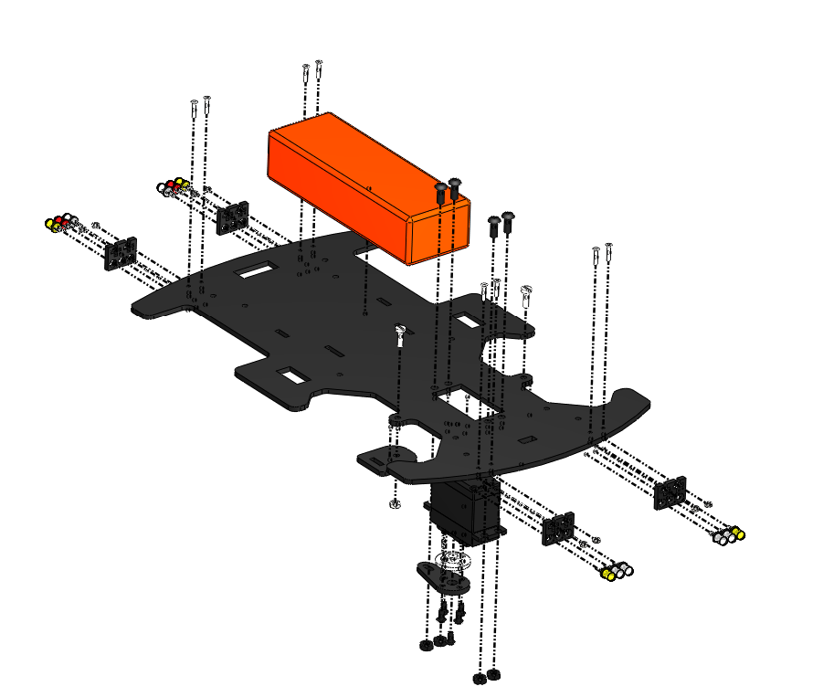
3
6
5
2
7
4
1

Slide 15
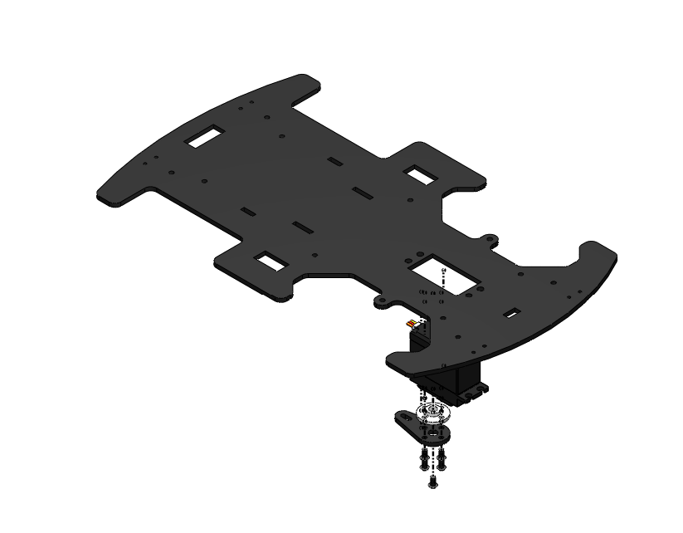
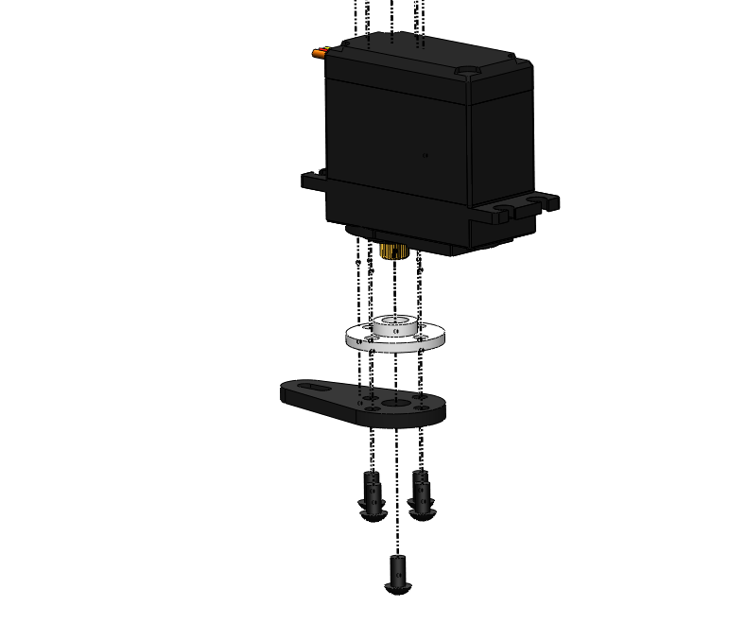

MOTOR TOP FACE MATES WITH BOTTOM FACE OF THE PLATFORM
M3 x 6 BOLT

Slide 16
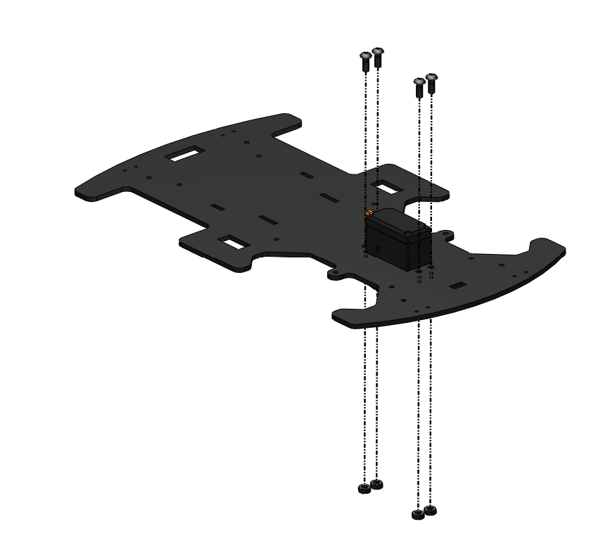

M4 x 10 BOLT
M4 NUT

Slide 17
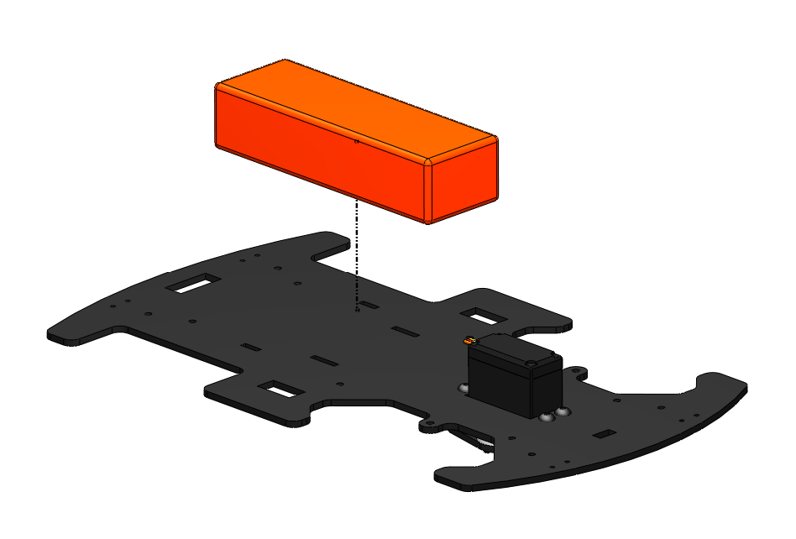
BATTERY STRAP SLOTS
BATTERY STRAP SLOTS

Slide 18
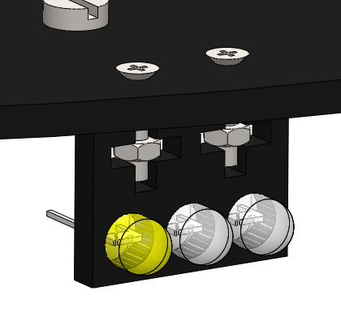
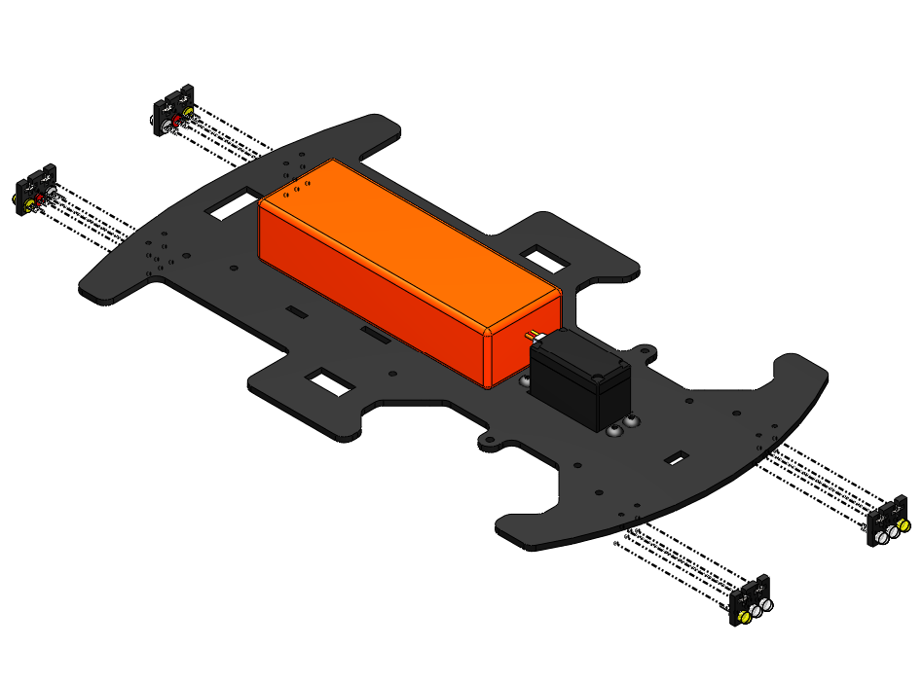
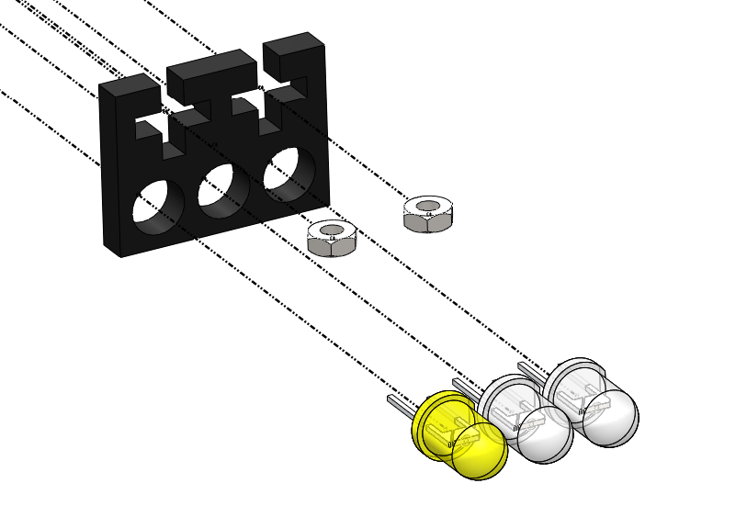
M2 NUT

Slide 19
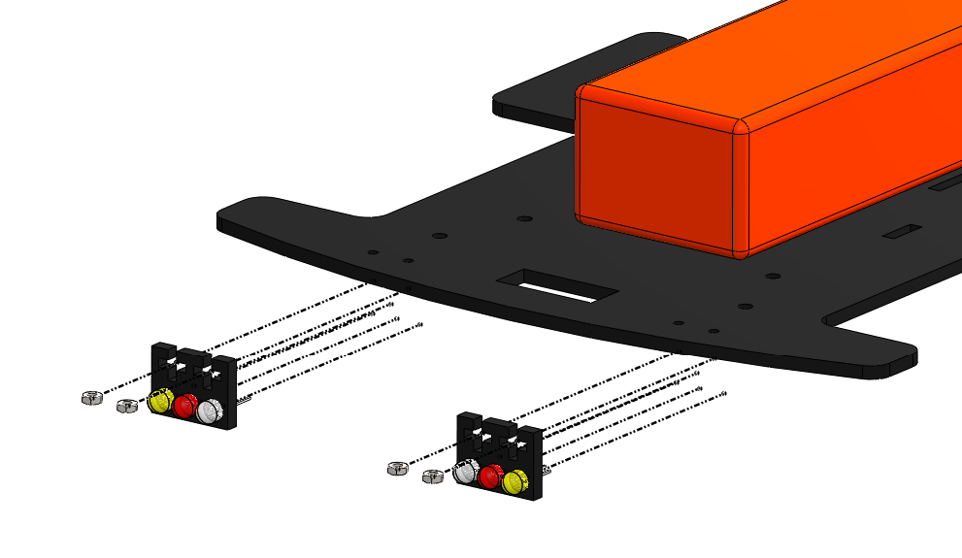
M2 NUT

Slide 20
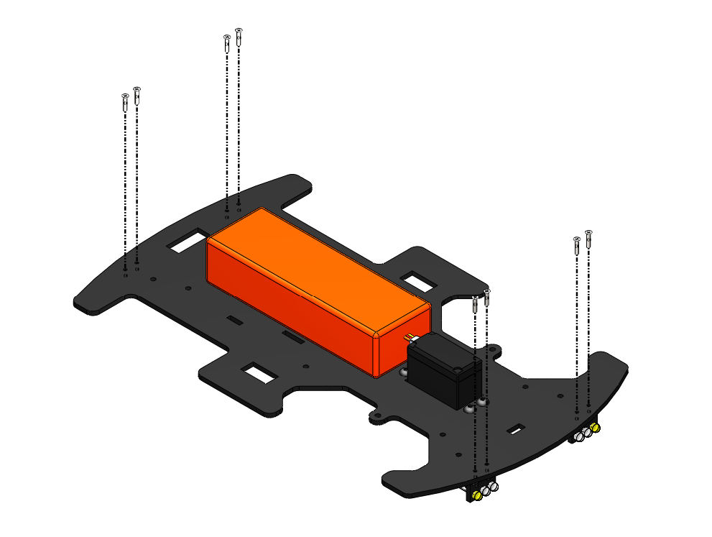
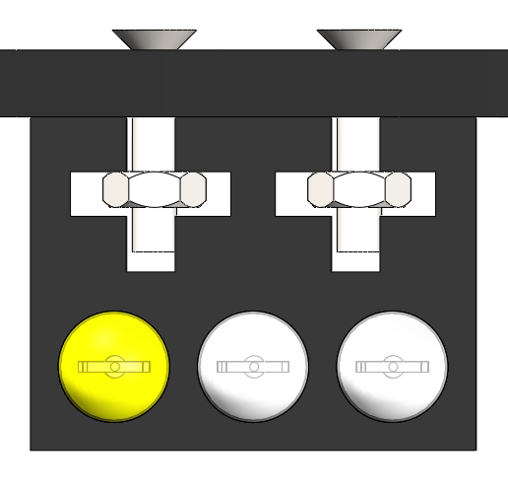
M2 x 10 BOLT

Slide 21
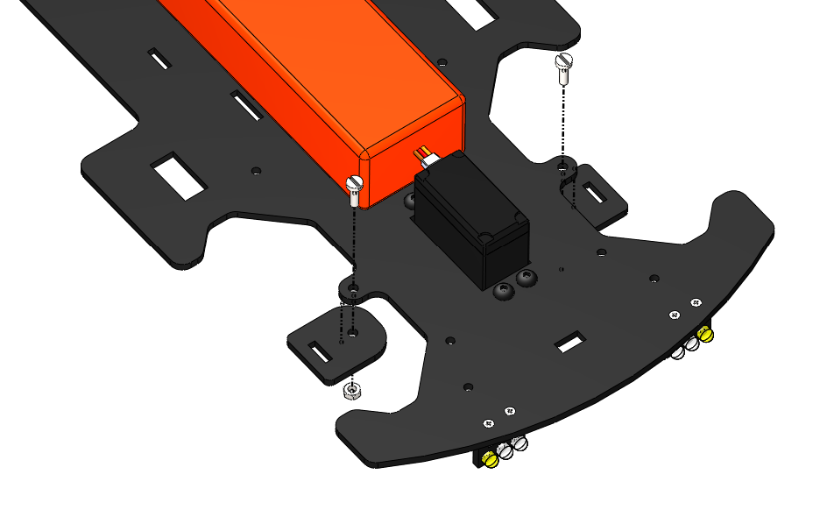
M3 X 10 BOLT
M3 NUT

Slide 22
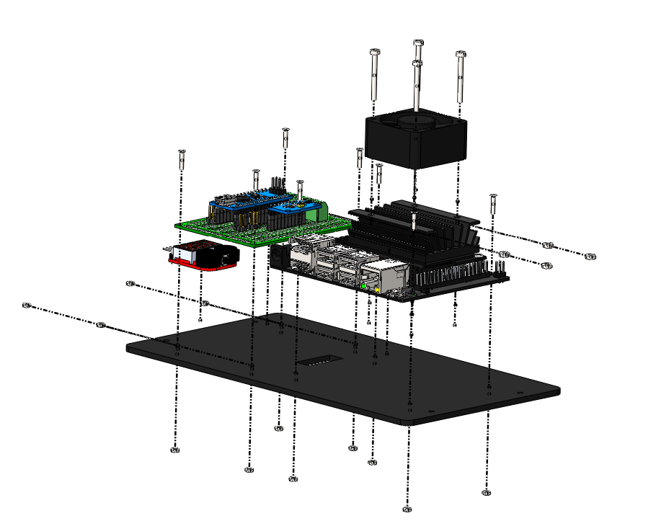
1
3
4
2

Slide 23
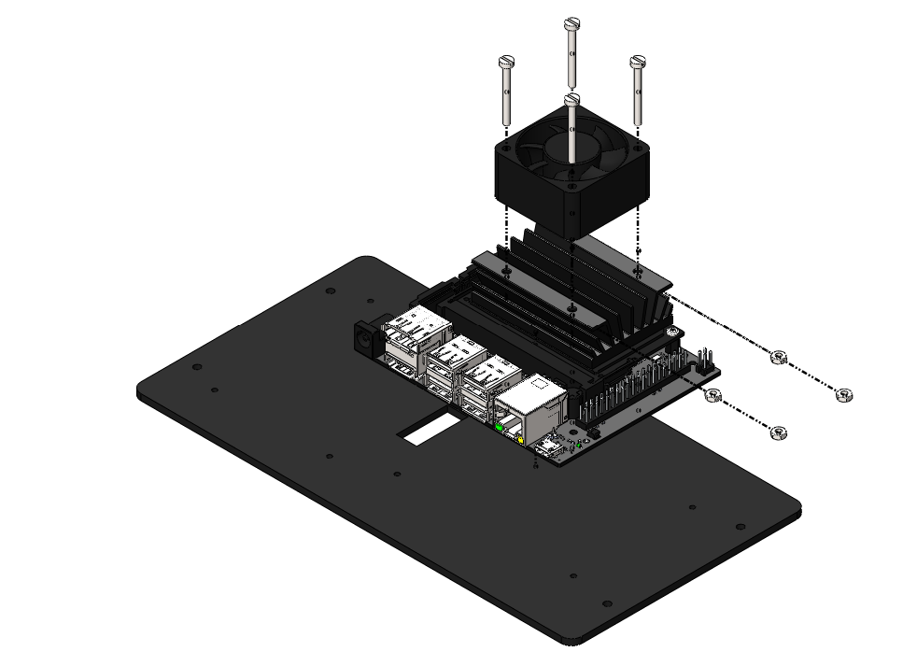
M2.5 x 25 BOLT
M2.5 NUT

Slide 24
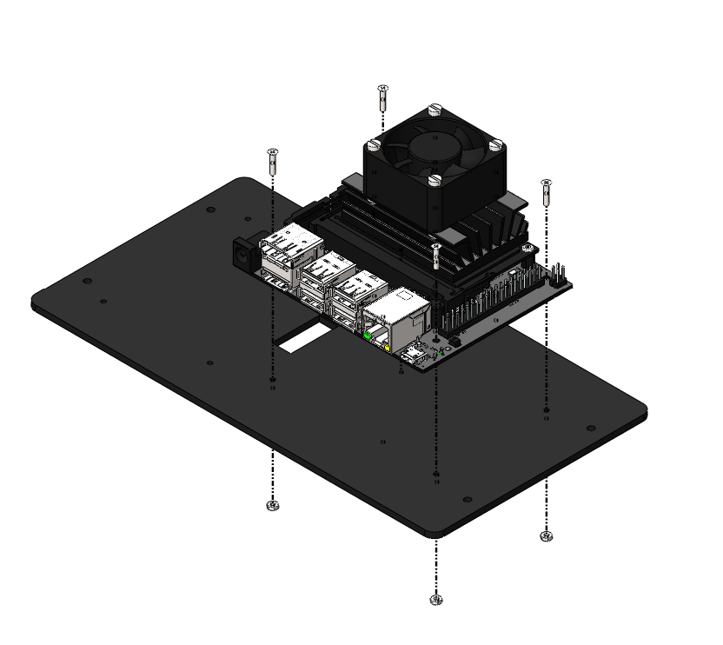
M2 x 10 BOLT
M2 NUT

Slide 25
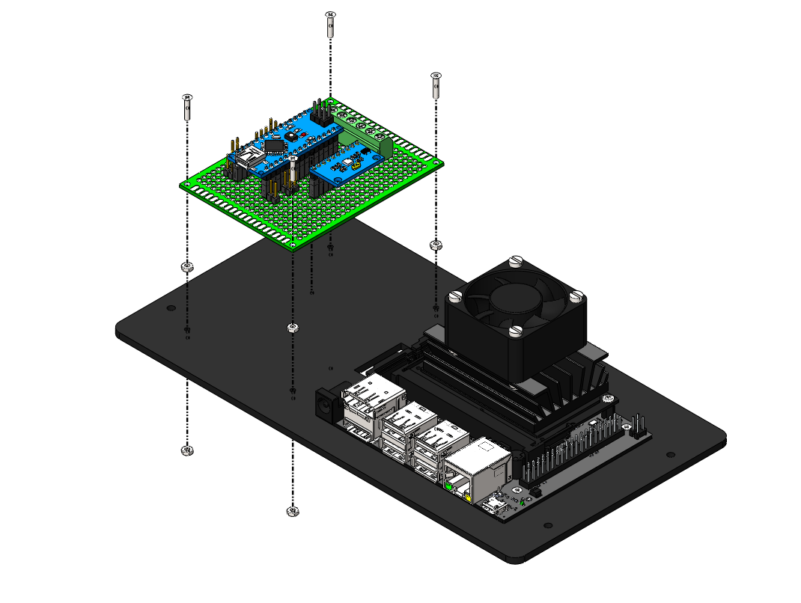
M2 x 10 BOLT
M2 NUT AS A SPACER
M2 NUT

Slide 26
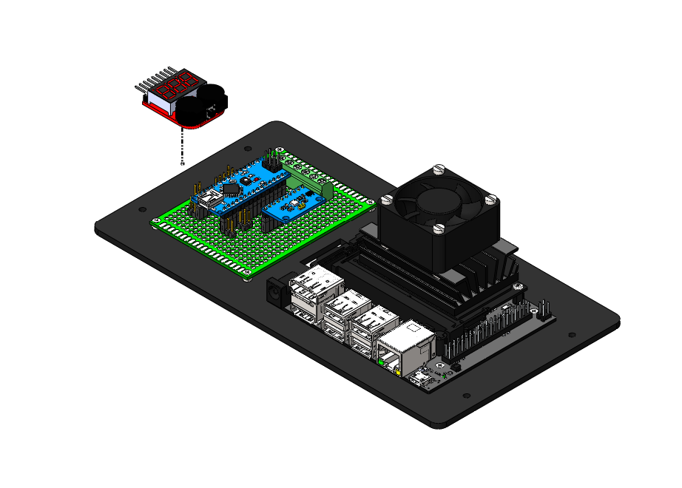
DOUBLE SIDED TAPE

Slide 27
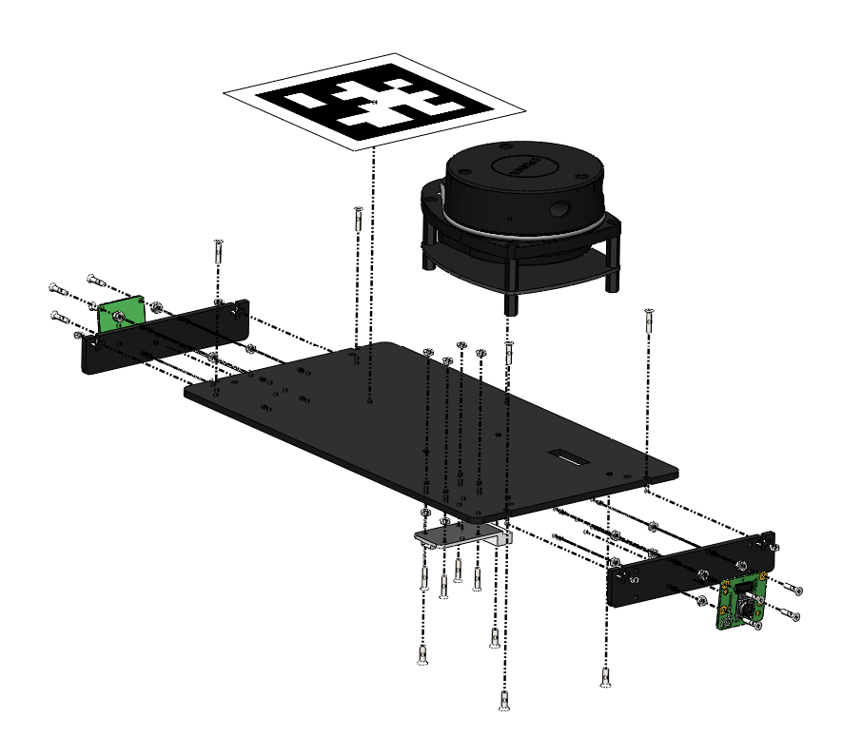
5
4
2
3
1

Slide 28
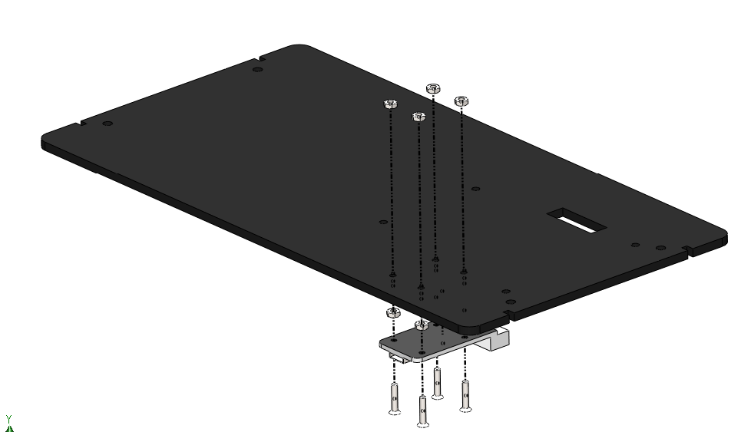
M2 NUT
M2 NUT AS A SPACER
M2 x 10 BOLT

Slide 29
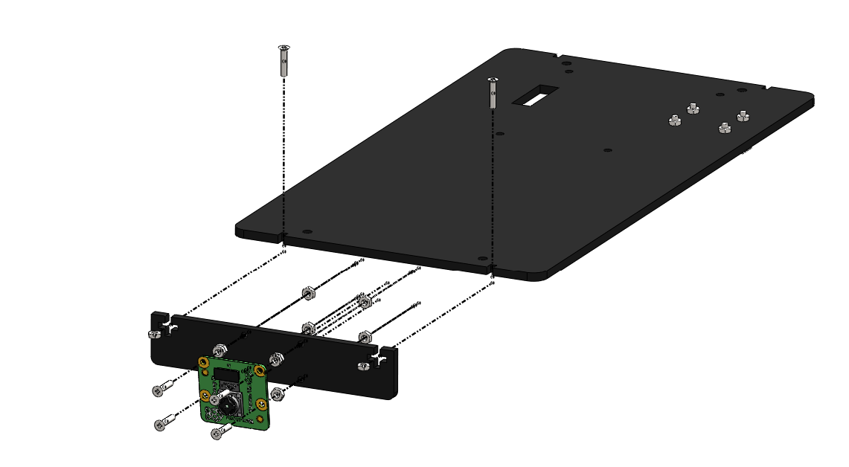
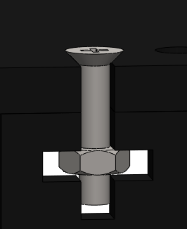
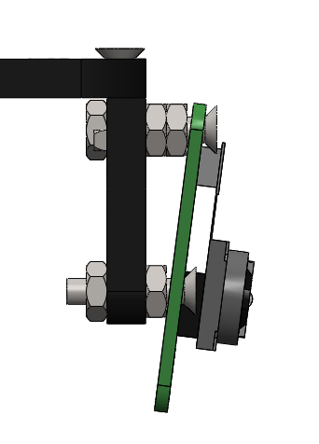
M2 x 10 BOLT
2 NUTS ON TOP
M2 NUT
M2 NUT
M2 x 10 BOLT
SIDE VIEW

Slide 30
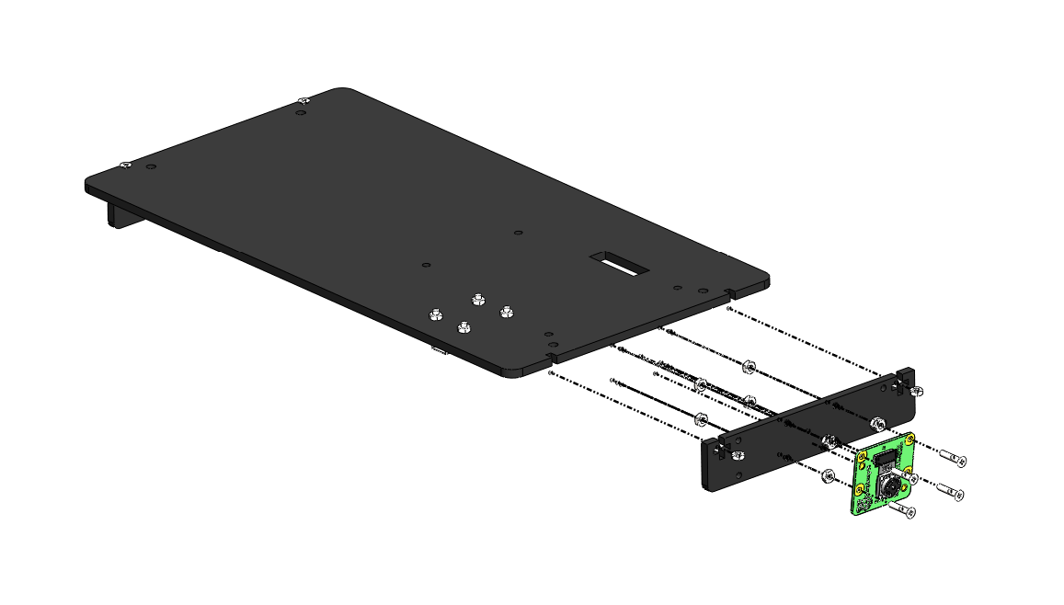
M2 NUT
M2 x 10 BOLT

Slide 31
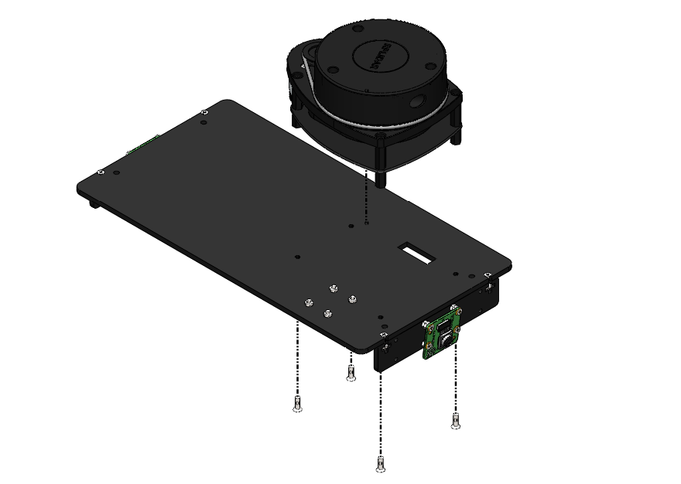
M2.5 x 8 BOLT

Slide 32
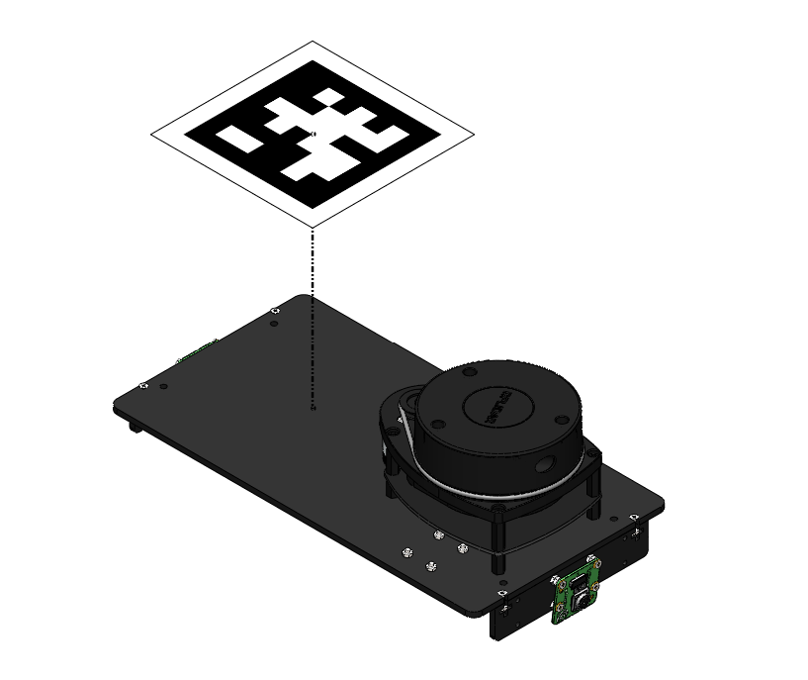
APRILTAG IS PASTED ON

Slide 33
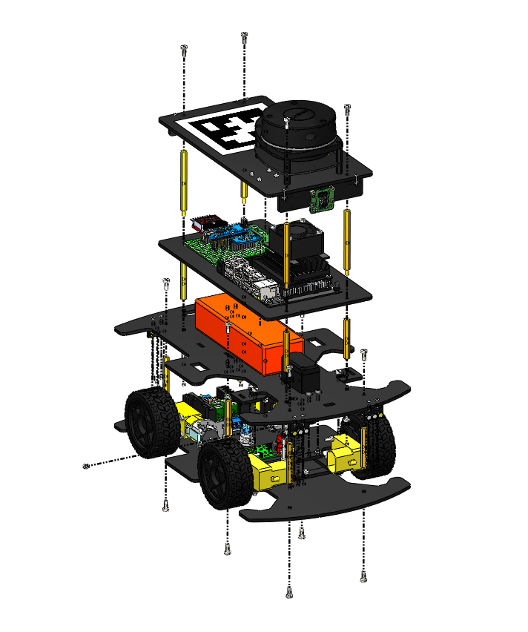
6
5
2
4
3
1

Slide 34
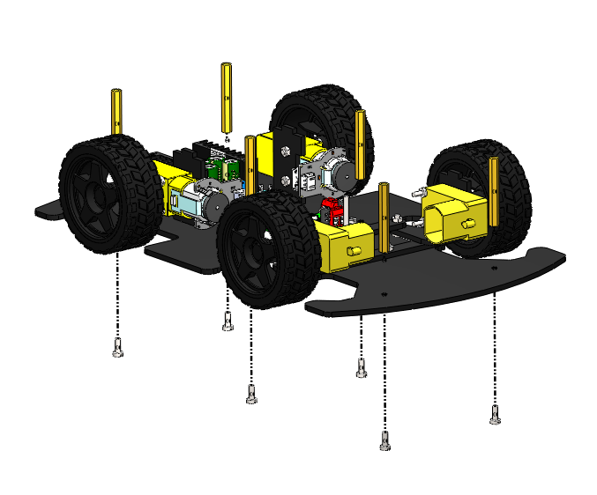
M3 x 40 F-F STANDOFF
M3 x 8 BOLT

Slide 35
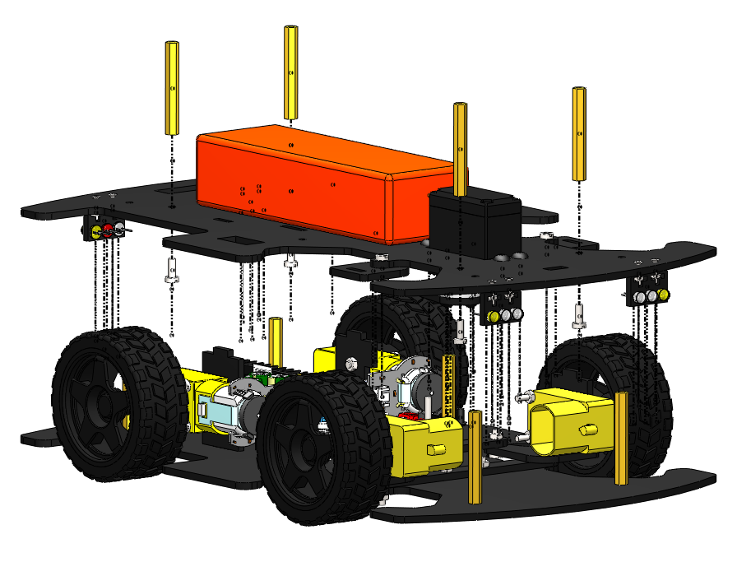
M3 x 40 F-F STANDOFF
M3 x 8 BOLT

Slide 36
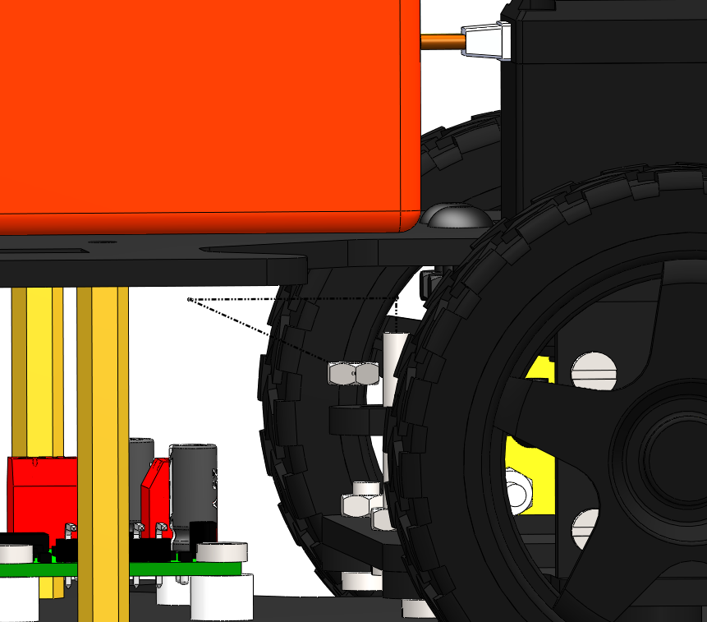
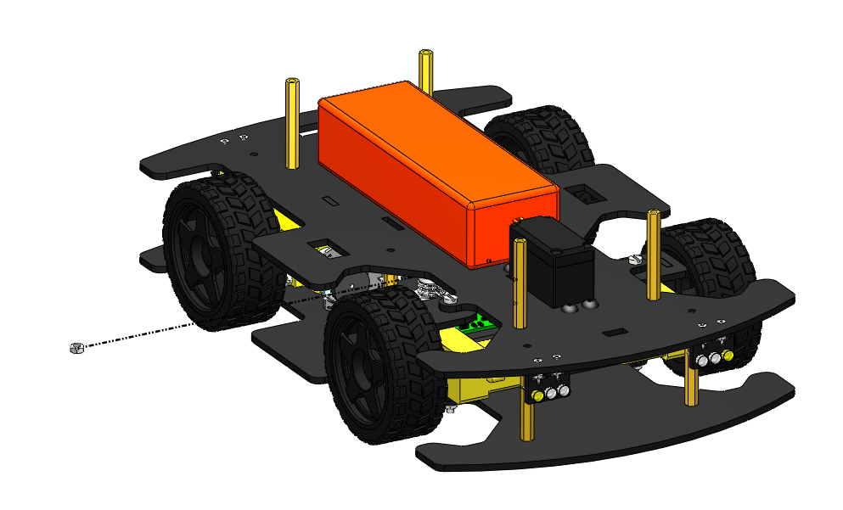
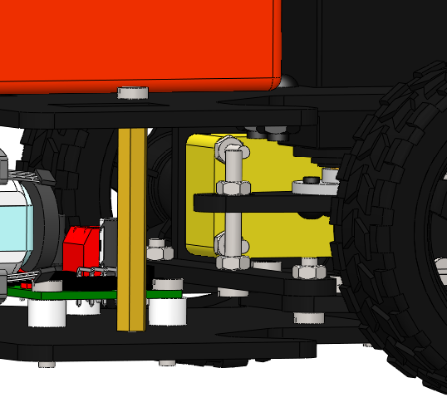
M3 NUT

Slide 37
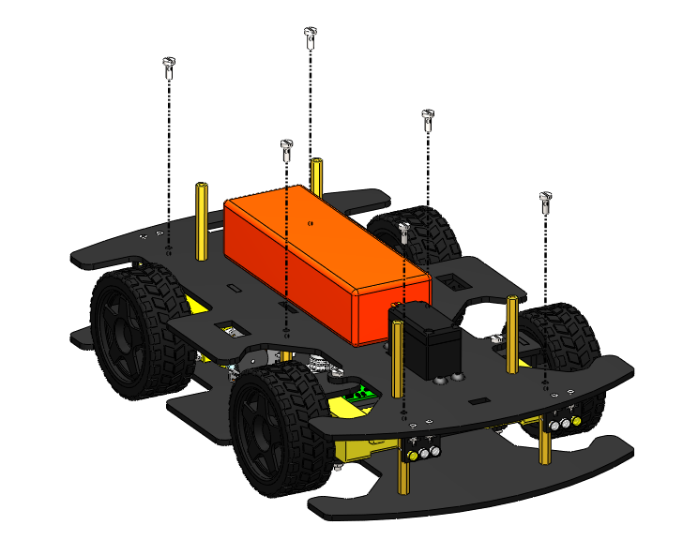
M3 x 8 BOLT

Slide 38
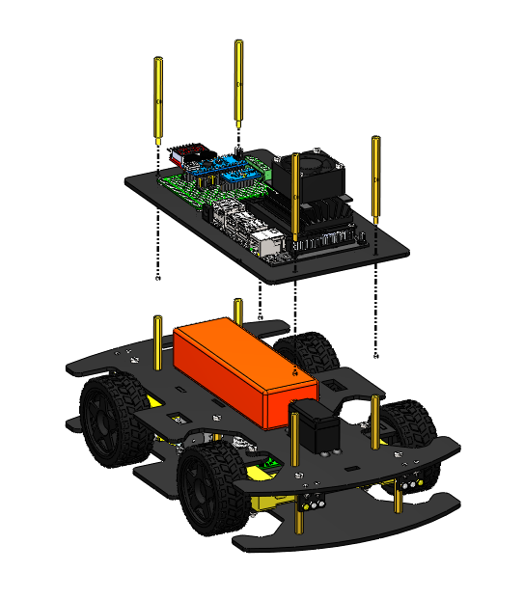
FEMALE SIDE
M3 x 60 M-F STANDOFF
MALE SIDE

Slide 39
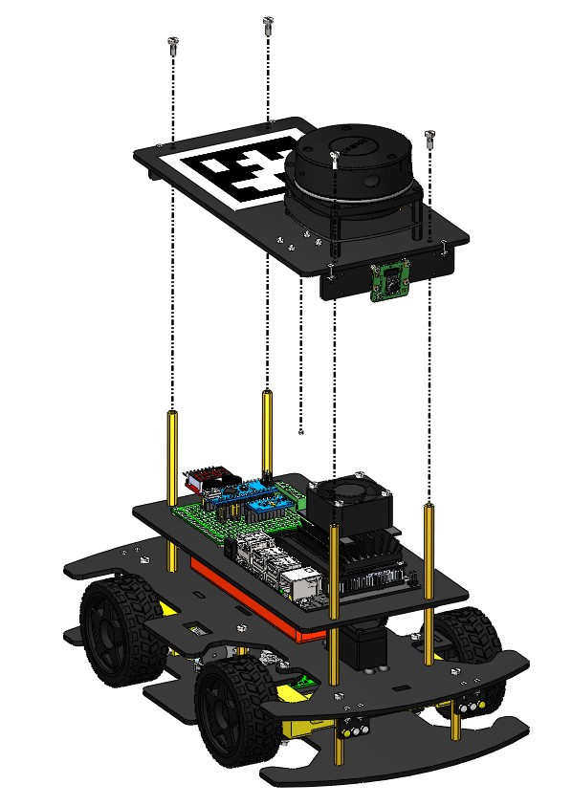
M3 X 8 BOLT

